Slide 1
Khilafat Movement & Non- Cooperation Movement
Dr. Asif Naveed

Slide 2
Historical Background.
The origin of Khilafat movement lies in the conception of relationship formulated by the Holy Quran which states” He hath appointed you his vicegerents in the earth.(6:165)
The Arab term in Vicegerents is Khalifah which word known as pre Islamic time.
in fact the term “Caliph” Khalifah received successor to the Prophet.

Slide 3
Kahalifat in islam:
The Institution of Khilafat occupies of any important place in the Islamic politics. In Islam this institution began with the selection of Hazrat Abubakar Sadiq as the successor of Holy prophet(S.A.W) in 632-634 AD. Then
Hazrat Umer 634-644
Hazrat Usman 644-656
Hazrat Ali 656-661 succedded the Prophet.
Thay were call Khulafa-e- Rashidin and this period is known as khalafat-e-Rashdin

Slide 4
These Caliphs were the temporal and spiritual head of entire Muslim world.
They were obliged by their faith and eminent position to defend the propagate Allah’s law as decreed by the Quran and to keep the traditions of the Prophet (S.A.W).
They were also to take the advice of other Muslims while formulating the policies of the state.

Slide 5
Umayyads and Abbasides
With the accession of Ameer Muavia this democratic nature of the Khalifa was changed with Monarchy.
The title of the caliph however continue to be used.
The Umayyads were succeeded by Abbasids.They were also called Caliph,
The result was that position of the caliph as the symbolic head of the Islamic world remained unchanged.
Even after the forces of decline had set in the Abbasids rule.

Slide 6
After the decline of Abbasides in 1258 the Khalifat passed into the hands of Fatimid rulers in Egypt and finally to the ottoman Sultans in the first half of the sixteenth century.
The ottoman Empire was the only Muslim power in 19th century which had maintained a semblance of authority.
The Indian Muslims looked upon it as the symbol of Islam
The British foreign policy toward Muslims especially Turkey continue to add the anxieties of the Indian Muslims.

Slide 7
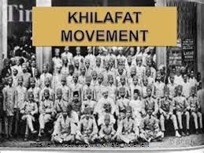

Slide 8
Khalifate Movement.
The WW1 was broke out in 1914.
The Indian Muslims desired that Turkey should not join it.
On August 1914 Molan Muhamma Ali sent a masseges to Turkey stating that it would be disastrous for Turkey and the entire Muslim world in it plunged into war and asked the Grand Wazir to think a thousand time before entering into war.
However in November 1914, Turkey decided to side with German against the British and his allies.

Slide 9
Turkey became an ally of Germany against Britain and
when Germany lost the war it was proposed that the Ottoman Caliphate be deprived of all its territories’
This caused an uproar among the Indian Muslims, and when the Treaty of Sevres was imposed, the protest became organized.

Slide 10
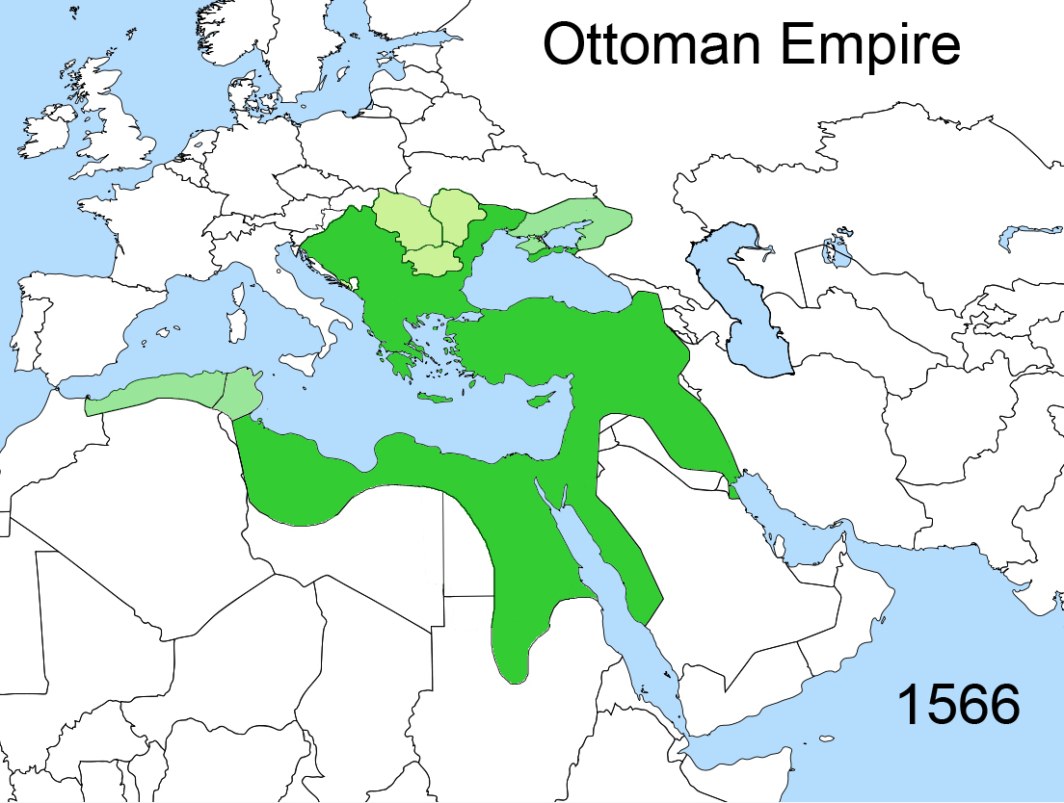

Slide 11
Gandhi joined the Muslim agitation over the Khilafat.
The Quaid-i-Azam discouraged discussion of the issue in the AIML Council and was overruled.
He wrote to Gandhi and warning him not to encourage religious sentiments, but Gandhi ignored him.
The Quaid-i-Azam wanted Hindus and Muslims to concentrate on Indian issues.

Slide 12
The Events
In 1919, the Khilafat Committee was formed and then the All India Khilafat Conference.
Gandhi was elected leader of the committee.
Hasrat Mohani moved a resolution calling for a progressive boycott of European goods-this was passed, but Gandhi opposed it.
Later he supported it and started a Non-Cooperation Movement.
In 1920, a seven-point resolution was passed in the Congress Session at Nagpur which the Quaid-i-Azam opposed, and consequently resigned from the Congress.

Slide 13
The Khalafat Deputation
On March 1920 a Muslims Deputation met the Prime Minister of Bratain Lloyed George; Muhammad Ali presented the Muslims demands , He put forward his three fold claim:
That the Khalafat shell not be dismembered.
That the Arab should remain in Muslims Control
That the Khalifa shell remain as therefore the warden of the Holy Places.

Slide 14
Treaty of Severs
In May 1920 “Treaty of Severs” has been published. This gave a severe shock for Indian Muslims.
According to this treaty The Arab countries become to be independent from Ottoman Empire.
Syria, Palestine and Mesopotamia were put under British and French mandates

Slide 15
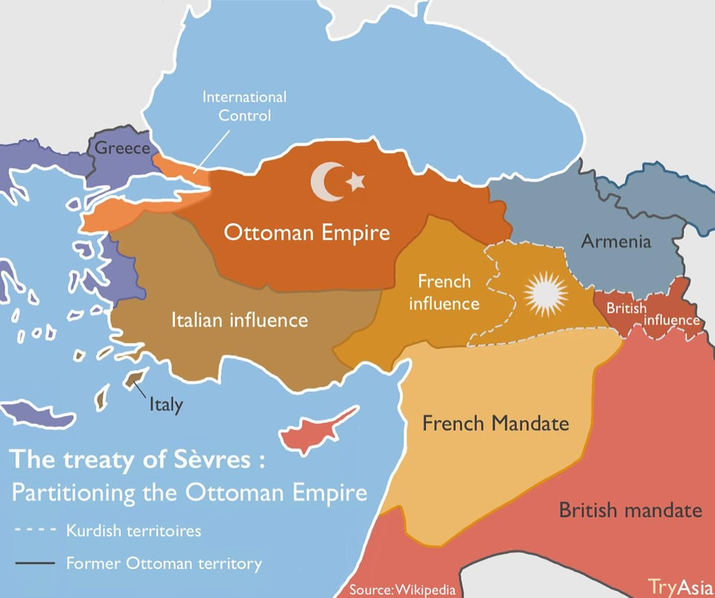
Partitioned of Ottoman Empire

Slide 16
The Leaders of Khalafat Movements
1. Haji Jan Mohammad Chotani (1873-1932)
2. Maulana Abdul Bari (18'78-1926)
3. Maulana Shaukat Ali (1873-1938)
4. Maulana Mohammad Ali Jauhar (1878-1931)
5. Maulana Abul Kalam Azad (1888-1958)
6. Dr Saifuddin Kitchlew (1888-1963)
7. Maulana Hasrat Mohani (188i-1951)

Slide 17
Non Cooperation Movement.
The failure of Khalafat delegation convinced the Muslims that their constitutional policy was futile and only with agitation they could fulfilled their demands.
Muhammad Ali came to conclude that “the Freedom of India of is absolutely necessary for the freedom of islam ”

Slide 18
The central Khalafat Committee organized a big public meeting at Bombay and adopt non cooperation as the only practice cause of action. The first instalment of Gandhi’s non cooperation movement was.
1. Surrender of all British titles
2. Refusal to attend the Govt. Functions
3.with draw all student from School and colleges
4.Boycott the British Courts
5.No Service in British army
6. No Participation in coming elections

Slide 19
Non-Cooperation
The Quaid supported some form of non-cooperation but was against extreme and impractical measures.
He agreed about surrendering titles given by the British, refusal to attend durbars or to serve in Iraq.
He opposed the boycott of schools, colleges, and law courts, and of foreign goods.
He felt Indian would be harmed by these boycotts as they had no replacements for these goods and services.
The high point of the movement was the trial of the Ali Brothers in Karachi.

Slide 20
The End of the Movement
This movement. because of its fervor, had a fair chance of success since the British had been wakened by the First World War, but the following external factors brought it to an end.
1. The Moplah's Uprising of August 1921:
Taking national liberation to mean social liberation, the Muslim Moplahs of Malabar set upon their Hindu landlords, killing and looting them. This damaged both Hindu-Muslim relations
and Gandhi's creed of non-violence. However. leaders from both sides controlled the extent of the damage.
2. The Chauri Chaura Incident of 5 February 1923:
police fired on unarmed protesters in the village of Chauri Chaura. In retaliation twenty two policemen were rounded up and burnt to death. Terming this act as an end to non-violence.
Gandhi called off his Non-Cooperation Movement leaving the Khilafat cause in the lurch.

Slide 21
3.The Abolition of the Caliphate-October 1924:
The Grand National Assembly of Turkey itself abolished the office of Caliph or Khalifa.
One leader of the Khilafat Movement, Maulana Abul Kalam Azad, agreed with the Turkish decision and advised Indian Muslims to leave Turkey to its own fate and to concentrate on matters closer to home.
Thus, what Jinnah said at the beginning of the Khilafat Movement, Azad repeated at its end.

Slide 22
Results of the Movement
ln 1921, the greatest disaster was the Hijrat Movement, when Maulana Jauhar urged Muslims to migrate to Afghanistan.
Afghanistan closed its borders. Many Muslims who had sold their property cheaply were ruined, while many others died.
Dr Saifuddin Kitchlew and some other Khilafat leaders spoke out against the Luckhnow Pact,calling it unnecessary. Many Hindus joined their stance, and this made the separate electorate issue controversial.

Slide 23
The AIML was weakened.
However, experience was gained in mass agitation, organizing of processions, conducting of strikes and going to jail. This cadre of experienced workers made the struggle for Pakistan possible.

Slide 24


